Slide 1
​ AR FURNITURE CUSTOMIZER

Slide 2
Problem Recap
Users cannot visualize furniture in their real environment before purchase
Results in wrong size, color, and placement decisions
High return rates increase cost for e-commerce platforms
Lack of immersive and interactive experience reduces user confidence
Need for a smart solution to bridge online and real-world visualization gap

Slide 3
Objectives (Refined)
Develop an AR-based furniture customization system
Enable real-time visualization of furniture in user environment
Provide dynamic customization (size, rotation, color, texture)
Improve decision-making accuracy
Enhance user experience and reduce product returns

Slide 4
Literature Survey Update
Author & Year | Approach | Technology Used | Key Outcome | Gap Identified
Henderson (2011) | AR Training | AR-based instruction | Improved learning efficiency | No real-world interaction
Minogue (2006) | Haptic Learning | Touch systems | Better understanding | High cost
Dünser (2012) | AR Education | Interactive AR | Increased engagement | Low realism
Moro (2017) | AR/VR Learning | Immersive tech | Improved spatial skills | Needs infrastructure
Radianti (2020) | Review Study | AR/VR systems | Better outcomes | Integration complexity
Zhang (2021) | AR + Interaction | Multi-modal systems | Improved retention | Calibration issues
IKEA Place (2017) | AR Shopping | ARKit/ARCore | Real-time visualization | Limited customization
Houzz (2019) | Interior Design | Mobile AR | Better UX | Limited accuracy
Kim et al. (2022) | AR Retail | 3D visualization | Better decisions | Performance issues
Li et al. (2023) | AR Customization | AI + AR | Personalization | High computation

Slide 5
Literature Survey Update
Existing systems like IKEA Place focus mainly on visualization
Limited support for customization and personalization
Research highlights AR as a key technology in retail transformation
Most applications lack advanced interaction features
Performance optimization remains a challenge in mobile AR

Slide 6
Research Gap Validation
Lack of real-time customization features in AR systems
Limited accuracy in object scaling and placement
Poor performance on low-end mobile devices
Absence of AI-driven recommendations
Need for user-friendly and efficient architecture

Slide 7
Proposed System Overview
Mobile-based AR application for furniture customization
Detects real-world surfaces using camera
Places 3D furniture models in real-time
Allows resizing, rotation, and texture modification
Provides interactive and immersive user experience

Slide 8
System Architecture
User Interface
AR Engine (Unity + ARCore)
Customization Module
3D Model Database
Camera & Sensors
Flow:
User → Camera → AR Engine → Customization → Display.

Slide 9
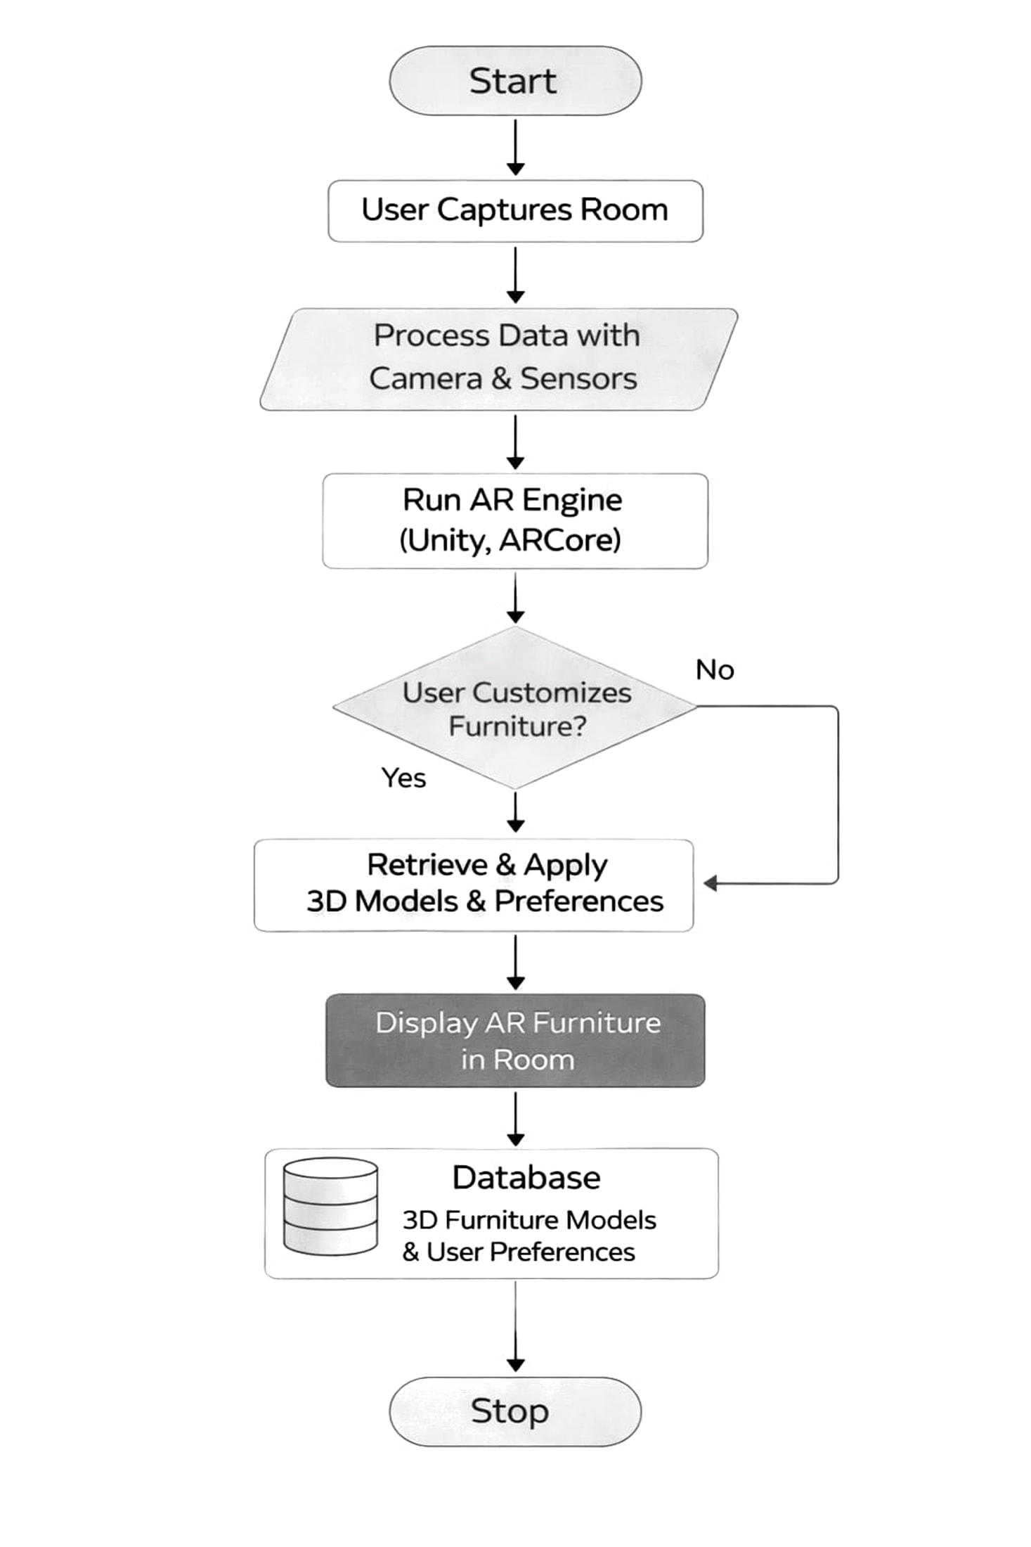
System Architecture

Slide 10
Methodology & Design
User interface design completed
AR environment successfully integrated
3D models added and rendered
Object placement functionality working
Customization module partially implemented

Slide 11
Tools & Technologies
Unity / Unreal Engine
ARCore / ARKit
Blender (3D models)
Android Studio

Slide 12
Tools & Technologies
Unity 3D for AR development
ARCore for motion tracking and environment understanding
Blender for 3D model creation
C# for scripting and logic
Android Studio for deployment and testing

Slide 13
Dataset & Setup
Dataset :
3D furniture models (chairs, tables, sofas)
Custom textures and materials
Setup :
AR-supported Android device
Unity with ARCore SDK
Camera-enabled environment.

Slide 14
Implementation Progress
User interface design completed
AR environment successfully integrated
3D models added and rendered
Object placement functionality working
Customization module partially implemented

Slide 15
Results / Current Output
Successful real-time AR furniture placement
Accurate surface detection achieved
Smooth interaction with 3D models
Improved visualization experience for users
Positive feedback from initial testing

Slide 16
Challenges Faced
Lighting conditions affecting AR tracking
Performance issues with high-resolution models
Device compatibility limitations
Complexity in real-time customization
Optimization of rendering performance

Slide 17
Future Work
Integration of AI-based recommendation system
Voice and gesture-based controls
Cloud-based model storage and updates
Multi-user AR collaboration
Full VR integration for immersive experience

Slide 18
Conclusion
AR Furniture Customizer enhances online shopping experience
Improves visualization and decision-making
Reduces product return rates
Provides interactive and engaging user interface
Strong potential for future advancements in AR/VR domain

Slide 19
References
Azuma, R. T. (2020). A Survey of Augmented Reality. IEEE Transactions on Visualization and Computer Graphics.
Google Developers. (2026). ARCore Developer Documentation. Available at: https://developers.google.com/ar
Unity Technologies. (2026). AR Foundation Documentation. Available at: https://docs.unity3d.com
Billinghurst, M., Clark, A., & Lee, G. (2021). A Survey of Augmented Reality Applications in Retail and E-commerce. IEEE Access.
Javornik, A. (2021). Augmented Reality: Research Agenda for Studying the Impact of AR on Consumer Behavior. Journal of Retailing and Consumer Services.
Yim, M. Y. C., Chu, S. C., & Sauer, P. L. (2020). Is Augmented Reality Technology an Effective Tool for E-commerce? Journal of Retailing and Consumer Services.
Google ARCore Documentation
Unity Official Documentation
IEEE Research Papers on AR in Retail
Springer Journals on AR/VR Applications
Online resources and tutorials

